Slide 1
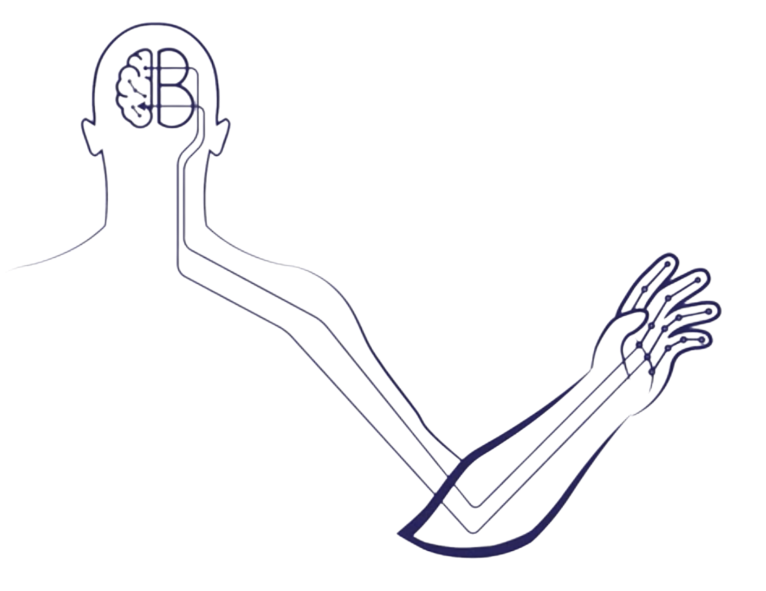
Modern BCI: the need for next-generation wireless technologies
Dr. Paul Wanda, PhD
Engineer & Project Manager
Blackrock Microsystems Europe GmbH
B-CRATOS Consortium Partner

Slide 2
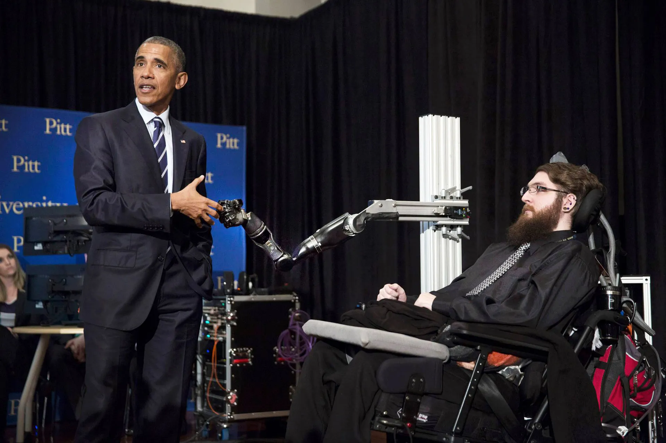
Great need for improved assistive and rehabilitative technologies
Example: Spinal Cord Injury
At least half a million estimated to be affected in Europe and the US
Terrible impact on quality of life
Up to a 4.5M Euro lifetime cost, not including lost wages, benefits, productivity
Less than 1% experience complete recovery before hospital discharge
Stroke (1.1M/yr EUR), ALS, many other indications
White House File Photo 2016
“Functional/Motor Outcome 5 years after Stroke is equivalent to outcome at 2 months”
(Meyer et al 2015, Stroke)
Neural Horizons Workshop, Gardanne, France – 19-02-2025
Dr. Paul Wanda, PhD - BRME
Notes:
ALS: 30k tetraplegia: 177k
PD: 1 million epilepsy: 3.4 million
ED: 30 million

Slide 3
What will be the impact of BCI?
BCI systems convert recorded brain activity into control signals for external devices, such as computers, prosthetics, vehicles, or even stimulators to restore movement to lost limbs.
Reduce reliance on outside care.
Empower new rehabilitative approaches.
Return to work and increased independence.
Neural Horizons Workshop, Gardanne, France – 19-02-2025
Dr. Paul Wanda, PhD - BRME

Slide 4
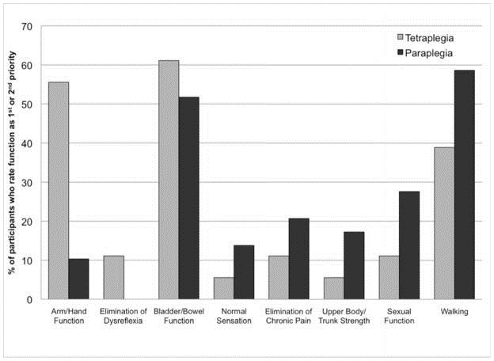
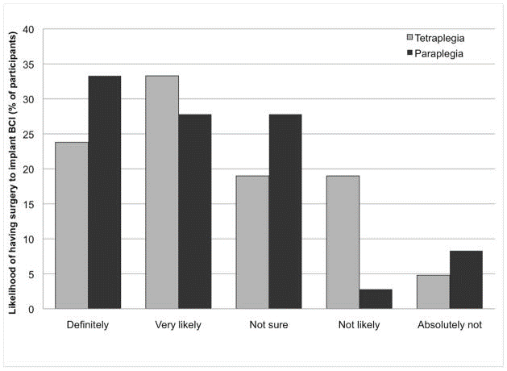
What do prospective users want?
SCI: Collinger et al 2013
Neural Horizons Workshop, Gardanne, France – 19-02-2025
Dr. Paul Wanda, PhD - BRME

Slide 5
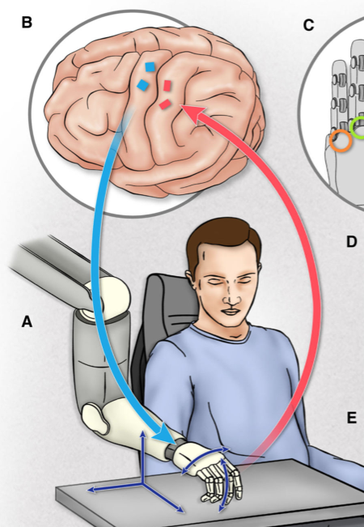
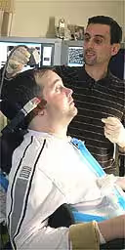
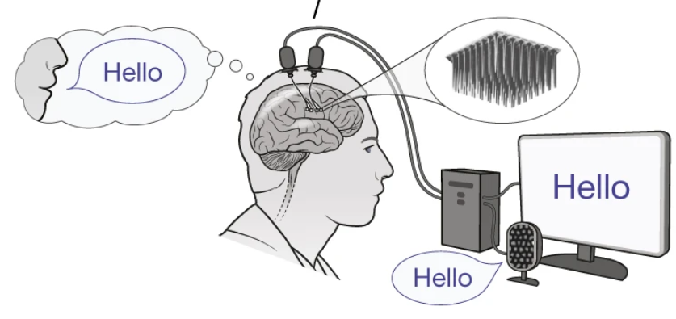
What has been demonstrated?
Img. The Guardian, 2005.
BrainGate 2004
Hochberg et al 2006
Device and prosthetic control
Fig. Willett et al 2023
60+ words/minute speech decoding
Fig. Flesher et al 2021
5D prosthetic control with tactile feedback
Neural Horizons Workshop, Gardanne, France – 19-02-2025
Dr. Paul Wanda, PhD - BRME

Slide 6
Where are the market-ready BCI systems?
There is a growing number of implantable devices on the market for other indications:
DBS for Parkinsons, Tremor, related diseases
RNS to treat Epilepsy
Peripheral stimulation systems (epilepsy, pain, etc.)
Cochlear implants
Similar characteristics to an imagined BCI system!
Fully implantable, electrodes in/near brain tissue, capable of data collection and/or stimulation, on-board logic, wireless powering
These devices have served as a model for many proposed BCI systems but there are critical differences as we will see...
Neural Horizons Workshop, Gardanne, France – 19-02-2025
Dr. Paul Wanda, PhD - BRME

Slide 7
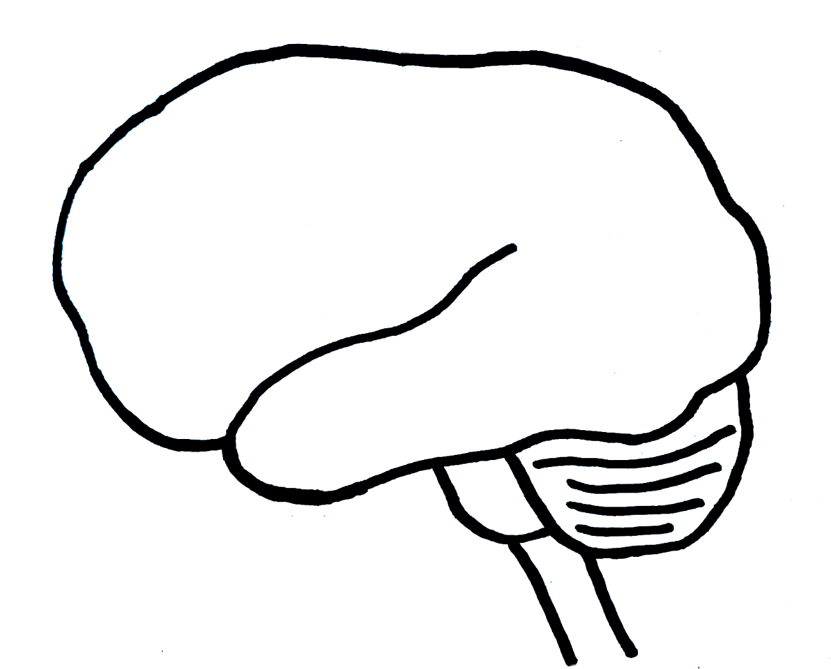
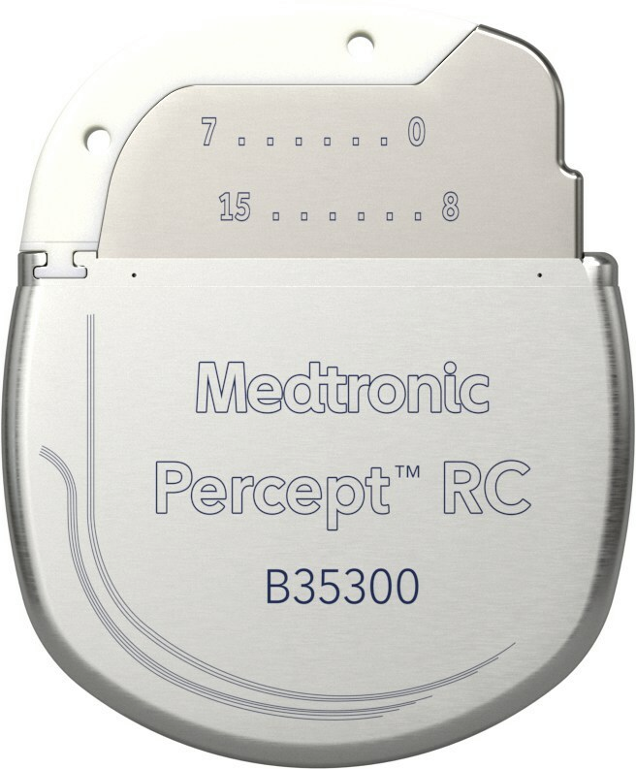
DBS treatment
DBS systems for Parkinson’s disease typically deliver stimulation to one of four electrode contacts (per hemisphere) and must not record data for the therapy
Implanted to chest, tunnelled wires to skull
Neural Horizons Workshop, Gardanne, France – 19-02-2025
Dr. Paul Wanda, PhD - BRME

Slide 8
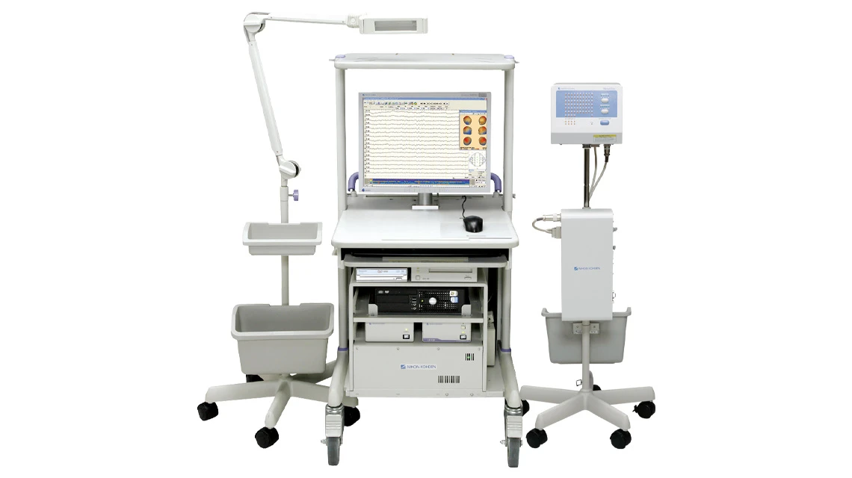
EEG/ECoG data collection for Epilepsy
To diagnose and localize focal epilepsy, clinical EEG systems sample data from hundreds of electrode contacts (usually 1kHz)
256 channels @ 16 bits → 4 Mbps
Wired devices in clinic
Percutaneous
Neural Horizons Workshop, Gardanne, France – 19-02-2025
Dr. Paul Wanda, PhD - BRME

Slide 9
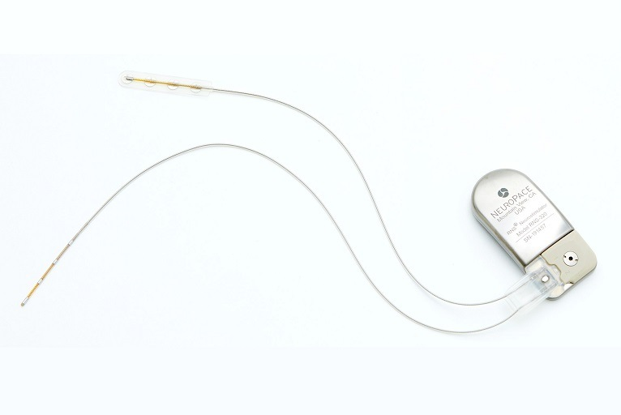
Epilepsy Treatment
The Neuropace RNS records from up to 4 pairs of channels, storing small snippets of data (250 Hz). Stimulates multiple channels.
4 channels @ 10 bits → 10 kbps
Fully implantable
Data stored on device. Most recent 4 minutes can be sent to external device.
Neural Horizons Workshop, Gardanne, France – 19-02-2025
Dr. Paul Wanda, PhD - BRME

Slide 10
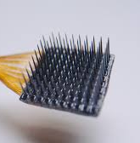
Data collection for BCI Research
BCI research programs typically implant 2 multi-electrode arrays, up to 128 channels per array, sampling ~30 kHz.
Chen et al 2020/2023 -> 1024 channels w/ 16 arrays
256 channels @ 16 bits → 122 Mbps
Wired devices with percutaneous connectors, large external hardware
Neural Horizons Workshop, Gardanne, France – 19-02-2025
Dr. Paul Wanda, PhD - BRME

Slide 11
BCI’s big data challenge
Unlike with the other therapies/devices, BCI has demanding needs for data:
High Number of Channels
Anatomical Coverage (not just surface but depth)
High sampling rate and data resolution
Microelectrodes: redundancy and stability for the long term
On-board processing/multiplexing can mitigate this need, but pose other challenges and sacrifices (ex. power, size)
Raw, high-quality neural data will be long in-demand to support new training models and algorithms, new biomarkers of disease
Neural Horizons Workshop, Gardanne, France – 19-02-2025
Dr. Paul Wanda, PhD - BRME

Slide 12
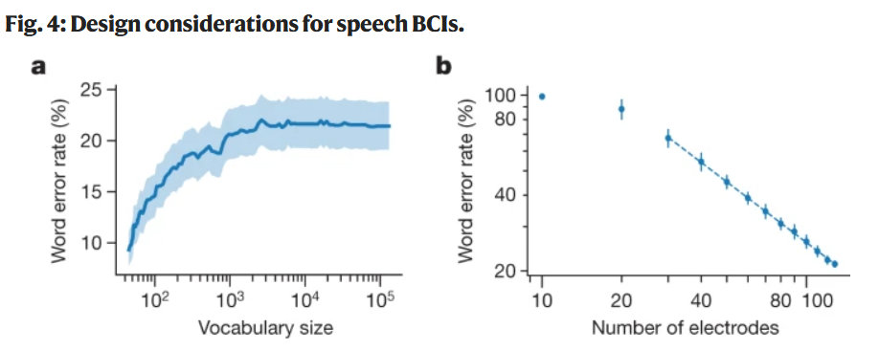
Do we need big data for BCI?
BCI control has been demonstrated using data collected at lower sampling rates, such as HF-LFPs (Flint et al 2013, Heldman and Moran 2020)
However, the gold standard remains spiking activity of single neurons in motor cortex (see left).
GPT-4 trained on 10 trillion words!
Need not only data volume, but also data quality
Fig. Willett et al 2023
Neural Horizons Workshop, Gardanne, France – 19-02-2025
Dr. Paul Wanda, PhD - BRME

Slide 13
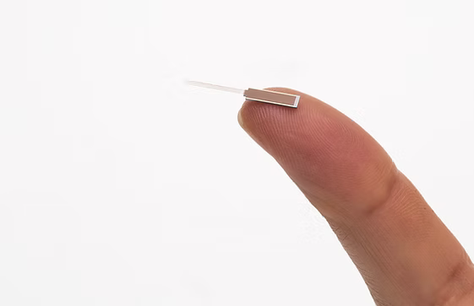
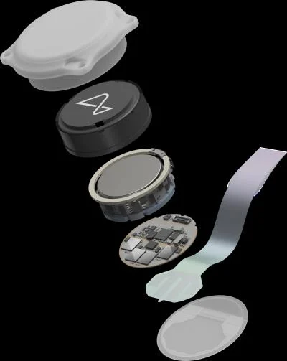
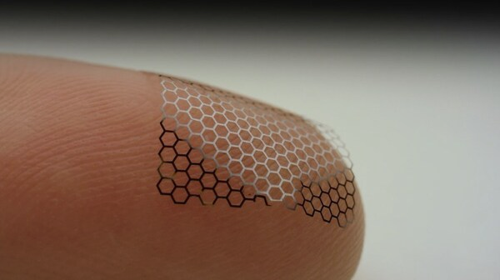
Do we need big data for BCI?
The electrode market is looking towards ever increasing channel counts for future BCI
Neuropixels 2.0
1280 recording sites per shank
5120 per device
Neuralink “Link”
96 electrode “threads” with 32 electrodes per thread (2019)
Blackrock “Neuralace”
and Axoft!
Ultrasoft HD electrodes
10000+ channels
Neural Horizons Workshop, Gardanne, France – 19-02-2025
Dr. Paul Wanda, PhD - BRME

Slide 14
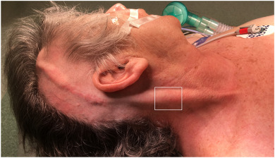
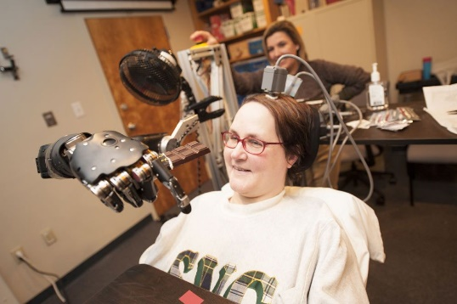
The need for WIRELESS solutions
Wires through the skin
Infection risk
Damage to device
Additional surgeries
Wires in the body
Same as above
Scar tissue formation (“bowstringing”)
Managing large numbers of channels/wires
Aesthetics, Everyday Use
Neural Horizons Workshop, Gardanne, France – 19-02-2025
Dr. Paul Wanda, PhD - BRME

Slide 15
Where does current wireless tech stack up?
Technology | Typical Data Rates | Compared to Basic Research BCI Need (~100 Mbps)
Zigbee | 250 kbps | 0.2%
MedRadio | 400 kbps (theor. higher) | 0.3%
NFC/RFID | 850 kbps | 0.7%
Bluetooth Low Energy (BLE) | < 1 Mbps (theor. ~2.1 Mbps) | 0.8%
Ultrawideband (UWB) | 10s of Mbps (theor. higher) | 8+%
Optical (var) | 10s of Mbps | 8+%
Neural Horizons Workshop, Gardanne, France – 19-02-2025
Dr. Paul Wanda, PhD - BRME

Slide 16
Where does current wireless tech stack up?
Technology | Typical Data Rates | Compared to Basic Research BCI Need (~100 Mbps)
Zigbee | 250 kbps | 0.2%
MedRadio | 400 kbps (theor. higher) | 0.3%
NFC/RFID | 850 kbps | 0.7%
Bluetooth Low Energy (BLE) | < 1 Mbps (theor. ~2.1 Mbps) | 0.8%
Ultrawideband (UWB) | 10s of Mbps (theor. higher) | 8+%
Optical (var) | 10s of Mbps | 8+%
B-CRATOS (RFBS, Fat-IBC) | 10s to 100s of Mbps | Target: 100%
Neural Horizons Workshop, Gardanne, France – 19-02-2025
Dr. Paul Wanda, PhD - BRME

Slide 17
A growing BCI landscape
Neural Horizons Workshop, Gardanne, France – 19-02-2025
Dr. Paul Wanda, PhD - BRME

Slide 18
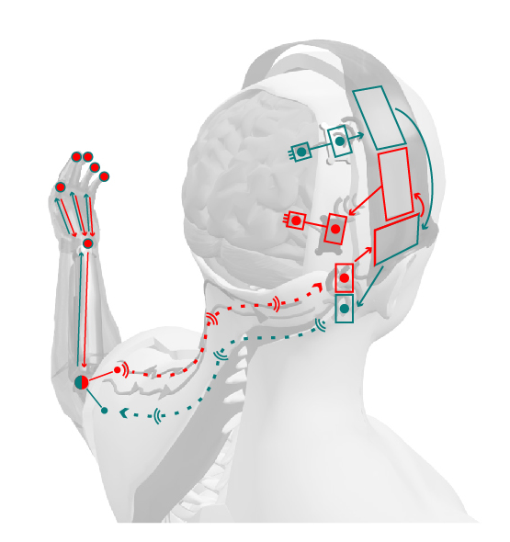
B-CRATOS: a vision of everyday BCI
B-CRATOS is pioneering a wireless implantable neural bypass platform designed to support big data applications.
Wireless Implants
Direct Brain Stimulation Feedback
- Very low energy wireless data transmission (< 50 mW)
- State of the art neural ASIC
- No implanted wires
- No implanted batteries
- Bidirectional data flow
- Micro-stimulation
- Big Neural Data Readout
- Sensorised prosthetic hand
Please attend to BCRATOS Team:
Dr. Augustine, Dr. Scherberger, Dr. Controzzi, and Dr. Khaleghi’s talks later in the workshop for more technical details!
Fat IBC Bidirectional In-Body Data
Neural Horizons Workshop, Gardanne, France – 19-02-2025
Dr. Paul Wanda, PhD - BRME

Slide 19
B-CRATOS Integrated System
We will demonstrate on the bench and animal demonstrator:
Low latency wireless readout and stimulation feedback from microelectrodes via backscatter and Fat-IBC channel (< 100 ms, first target: 32 Mbps)
Battery-less implant electronics
Data supports rapid decoding for hand prosthetic control
in vivo demonstrator in NHP (Scherberger Lab, DPZ)
Next generation (BCRATOS 2.0): refined prototype to support future pre-clinical and clinical trials (by 2029)
Neural Horizons Workshop, Gardanne, France – 19-02-2025
Dr. Paul Wanda, PhD - BRME

Slide 20
Neural Horizons Workshop, Gardanne, France – 19-02-2025
Dr. Paul Wanda, PhD - BRME

Slide 21
The B-CRATOS project has received funding from the European Union’s Horizon 2020 research and innovation programme under GA No 965044
Wireless Brain-Connect inteRfAce TO machineS
b-cratos.eu
please send comments to pwanda@blackrockneuro.com
Enabling Independence through Next-Generation Brain-Machine-Body Connectivity
Neural Horizons Workshop, Gardanne, France – 19-02-2025
Dr. Paul Wanda, PhD - BRME

